Slide 1
Valentino and the Arts

Slide 2
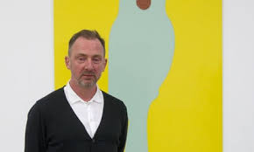
Gary Hume
Gary Hume is a British artist who came to prominence in the early 1990’s
His work is strongly associated with the Young British Artists movement. The Young British Artists was a group of artists that began to show their work in the late 1980’s. The group was known for utilizing found objects in their work and sometimes shocking subject matter
He is known for his large-scale paintings featuring bright colors and fragments from everyday life.
Some of his most famous paintings are known as “door paintings”

Slide 3
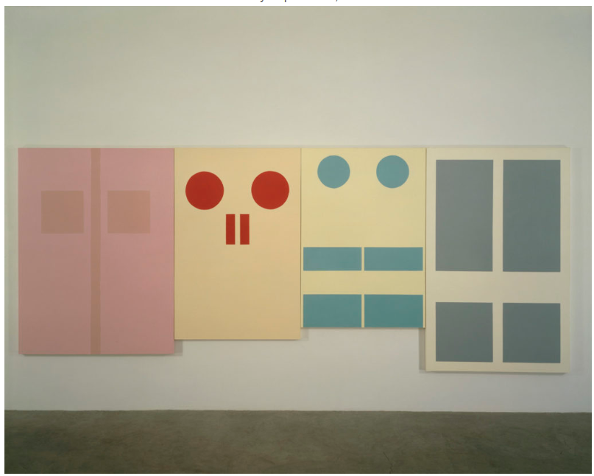
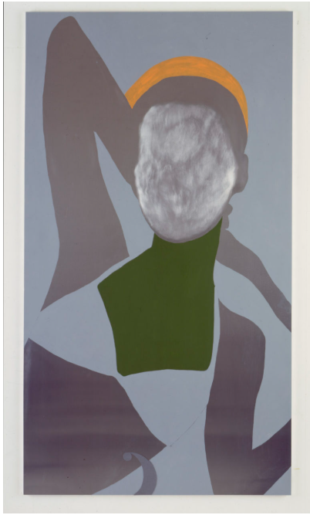
Examples of Gary Hume’s artwork

Slide 4
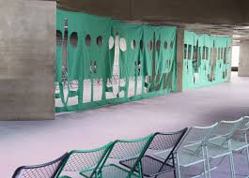
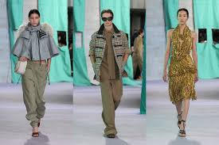
Burberry & Gary Hume
Burberry collaborated with Gary Hume to design the Summer 2025 runway set
The set is based on Hume’s Installation “Bays” that was first shown in London’s Dockland in 1990

Slide 5

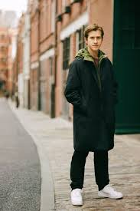
Why Gary Hume for Burberry now?
Daniel Lee became creative director of Burberry in 2022
Daniel Lee is a British designer
He took over from Riccardo Tisci, an Italian designer
He has been moving the brand in a traditional British direction since taking over

Slide 6
Burberry & Gary Hume – according to luxury theory
This collaboration demonstrates a desire for the brand to gain legitimacy from art.
The collaboration strategically highlights Burberry’s British roots and place in British culture by collaborating with an artist who is an important part of relatively recent British art history

Slide 7
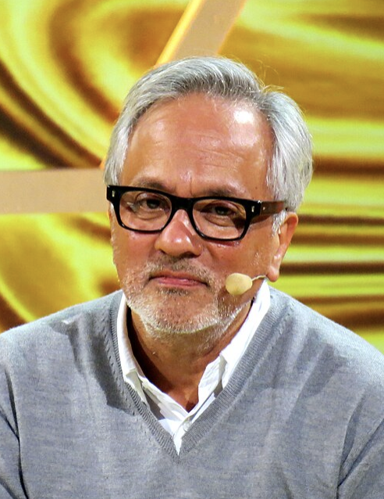
Anish Kapoor
Anish Kapoor is a British contemporary visual artist known for his work in sculpture, installation art, and conceptual art.
He has created notable works since the 1980s and has received multiple prestigious awards and honors including the Premio Duemila Prize at the 44th Venice Biennale in 1990 and the Turner Prize in 1991.
In the late 1980s and 1990s, Kapoor became known for his explorations of matter and non-matter, and after 1995, he gained widespread recognition for his innovative use of stainless steel.
One of his most famous works is Cloud Gate (often called "the Bean") in Chicago.

Slide 8
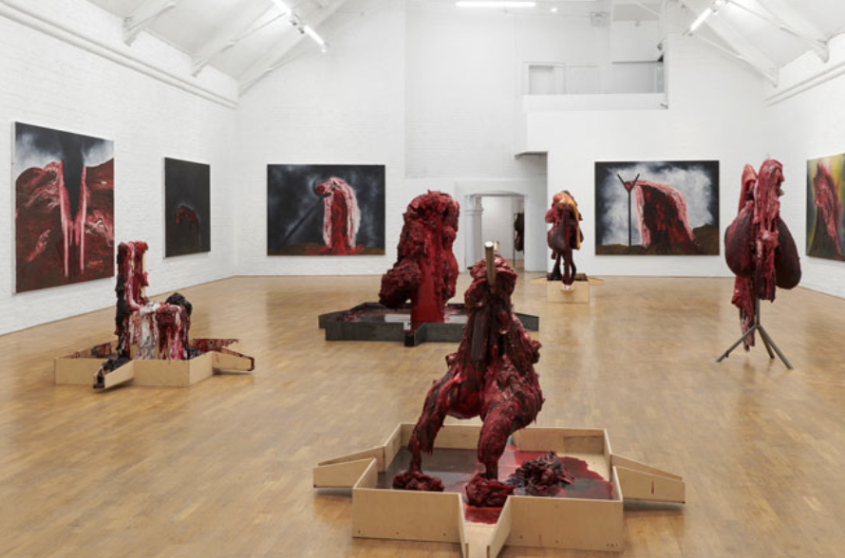
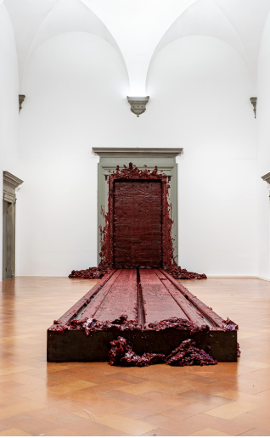
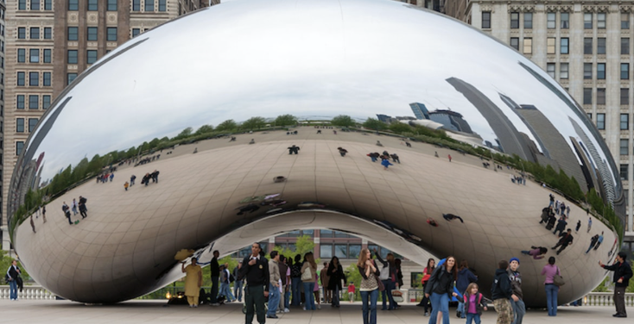
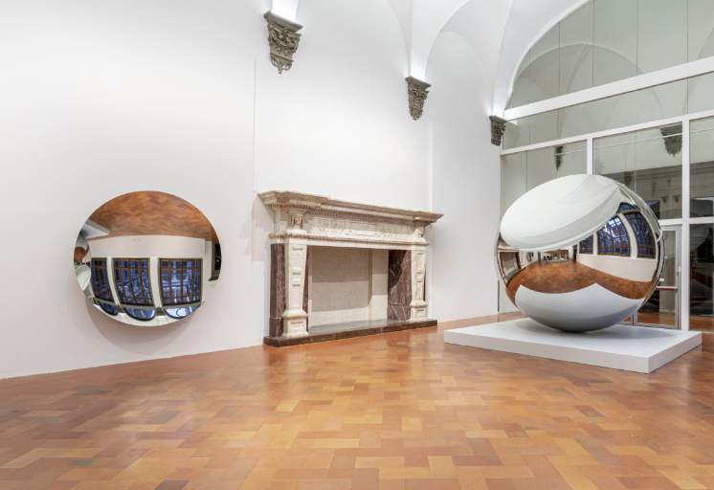
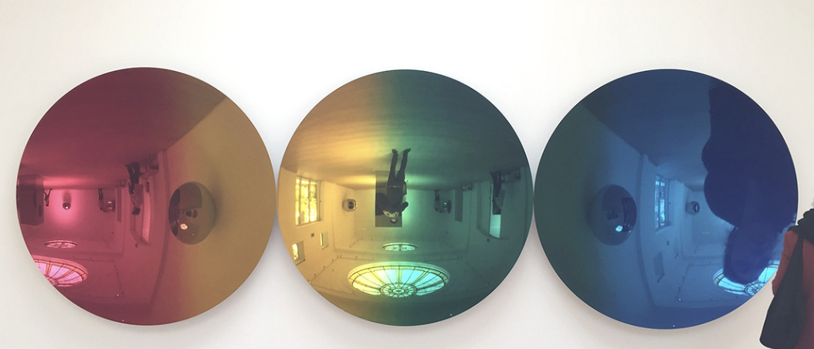
Examples of Anish Kapoor's Artwork

Slide 9
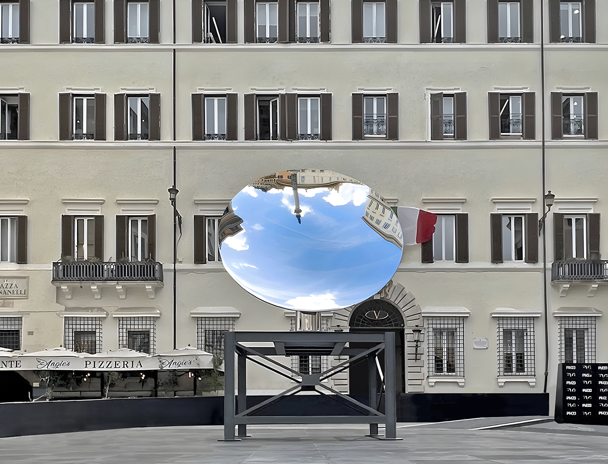
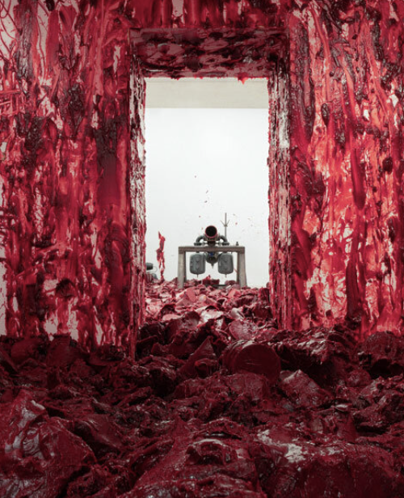
Valentino & Anish Kapoor
Valentino partners with Anish Kapoor for an immersive exhibition in Rome, Italy.
Hosted at PM23 (Palazzo Mignanelli 23), a newly restored cultural space created by the Valentino Garavani and Giancarlo Giammetti Foundation.
This exhibition explores the color red as a visual, symbolic, and identity shaping force (aligning with Valentino's aesthetic)
This collaboration demonstrates Valentino's commitment to fine art collaboration, craftsmanship, and experiential storytelling.

Slide 10
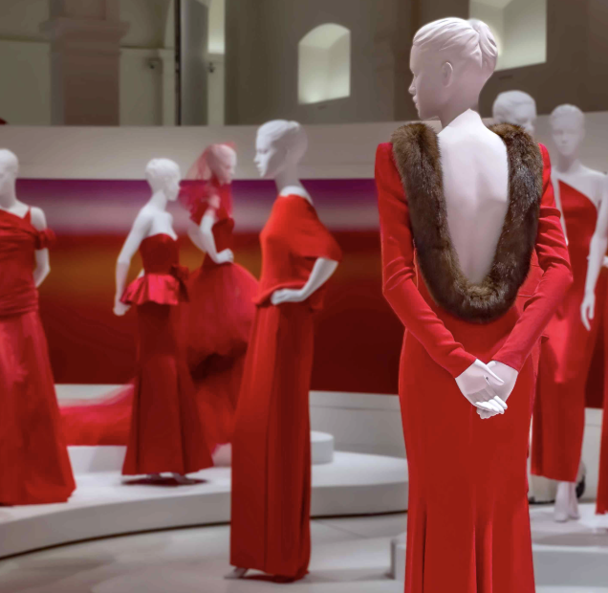
Why Kapoor for Valentino now?
Valentino is expanding its focus on art and cultural projects through the Valentino Garavani Foundation.
Anish Kapoor is a globally recognized contemporary visual artist.
The collaboration reflects Valentino's emphasis on bold color, emotion, and visual impact.
Kapoor's exploration of form and space aligns with Valentino's dramatic and sculptural aesthetic.

Slide 11
Kapoor and Valentino- according to luxury theory
This collaboration increases Valentino's prestige and credibility by connecting with a highly respected contemporary artist.
This collaboration also strengthens Valentino's symbolic value, positioning the brand within the world of high art.
The exhibits focus on Valentino Red transforms a brand signature into a cultural and artistic code, reinforcing brand identity.
This exhibit also reflects luxury's emphasis on experience and emotional meaning over product utility.

Slide 12
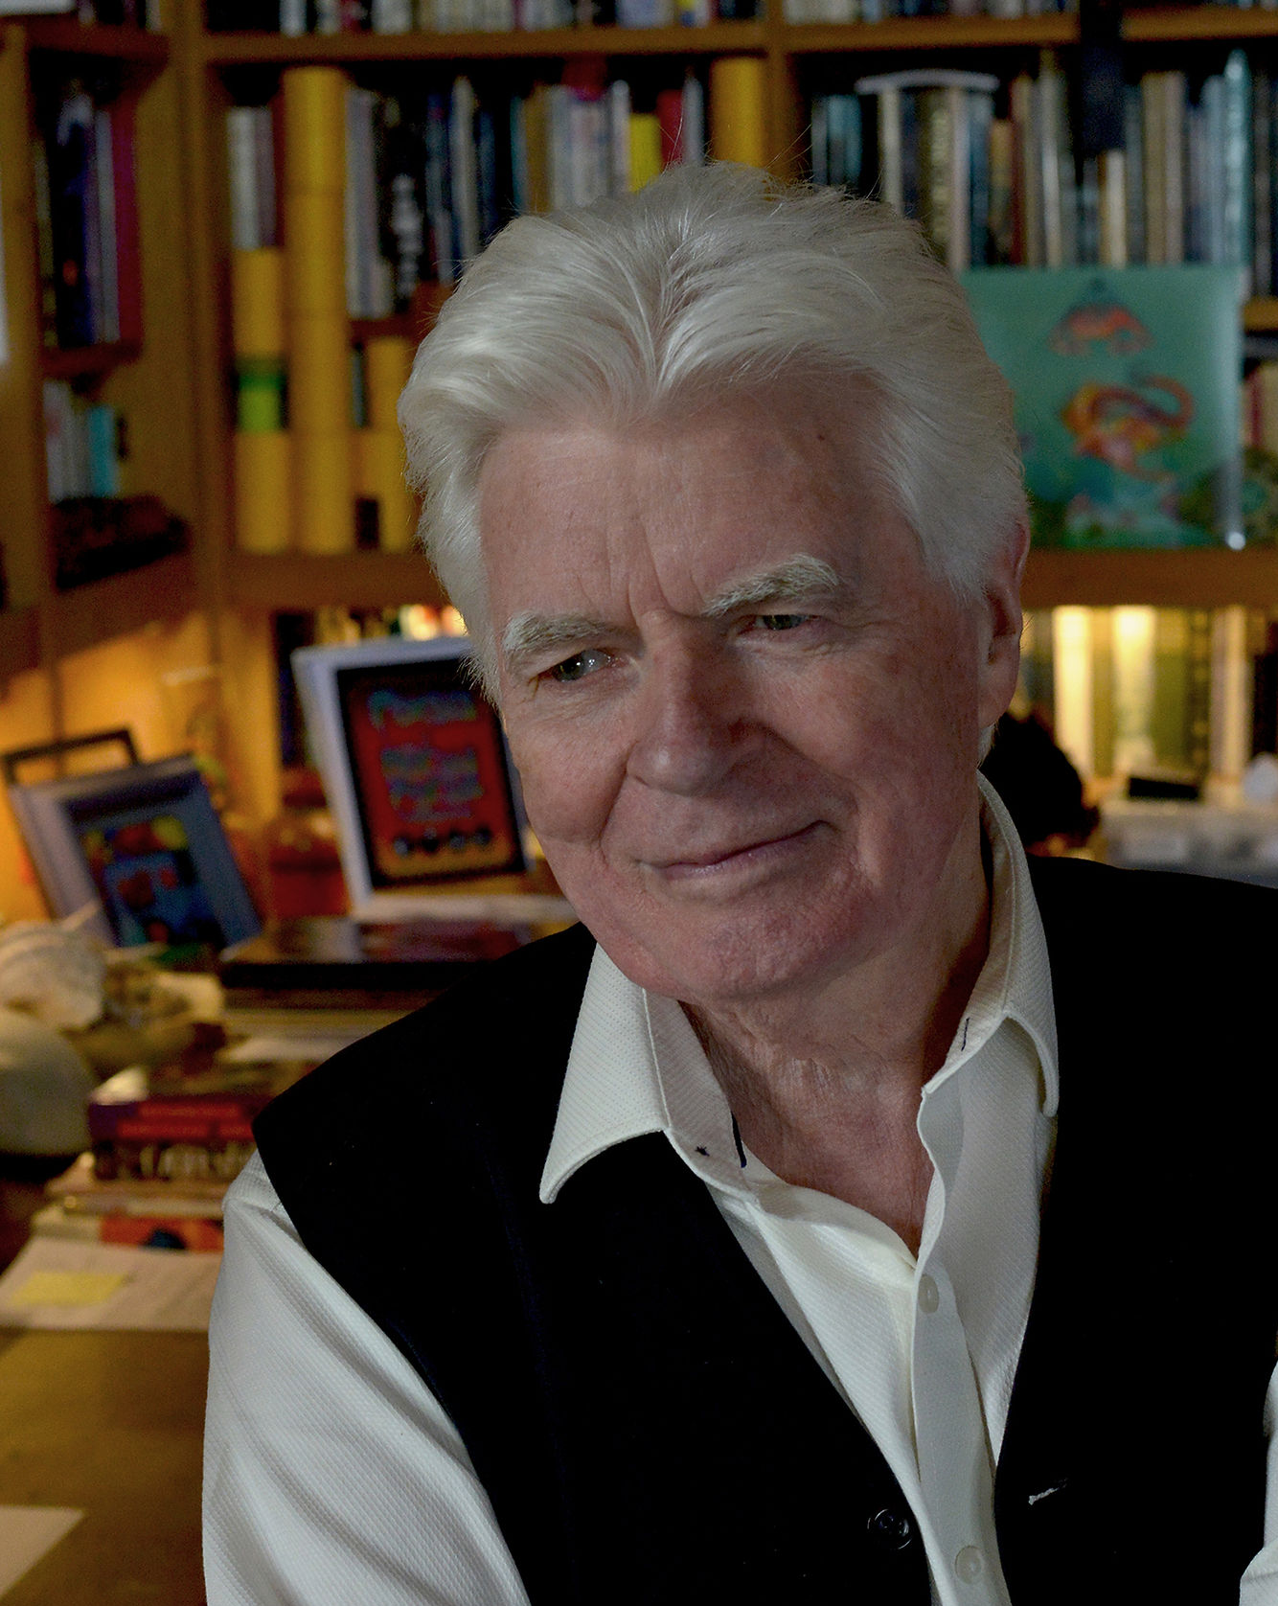
Roger Dean
Roger Dean is an English artist known for his unique style of album covers that feature many fantasy-inspired designs
He graduated from the Royal College of Art and many of his designs have been imitated through graffiti and major films
His trademark typography came from creating the album cover for Osibisa's first album
Along with being an artist, he also co-founded the publishing companies Dragons' Dream and Paper Tiger

Slide 13
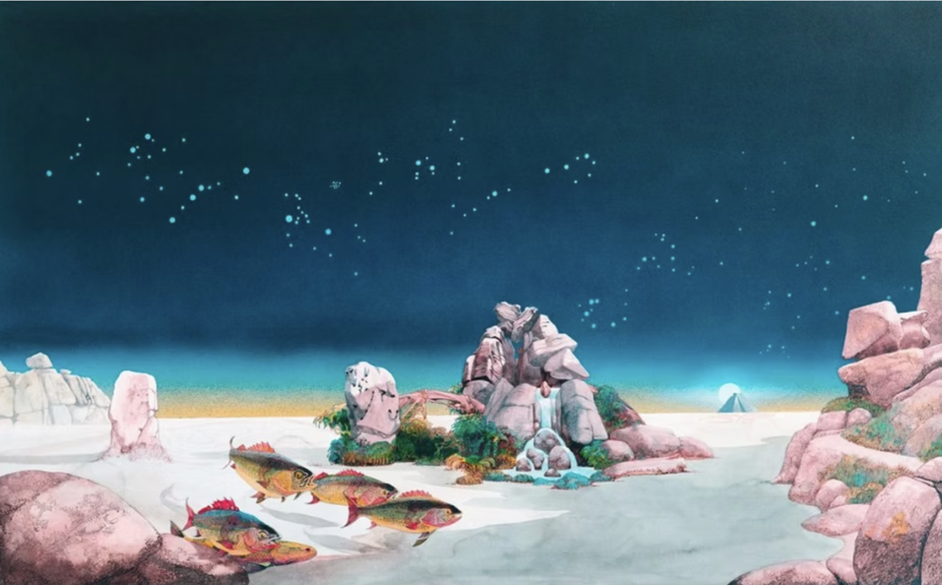
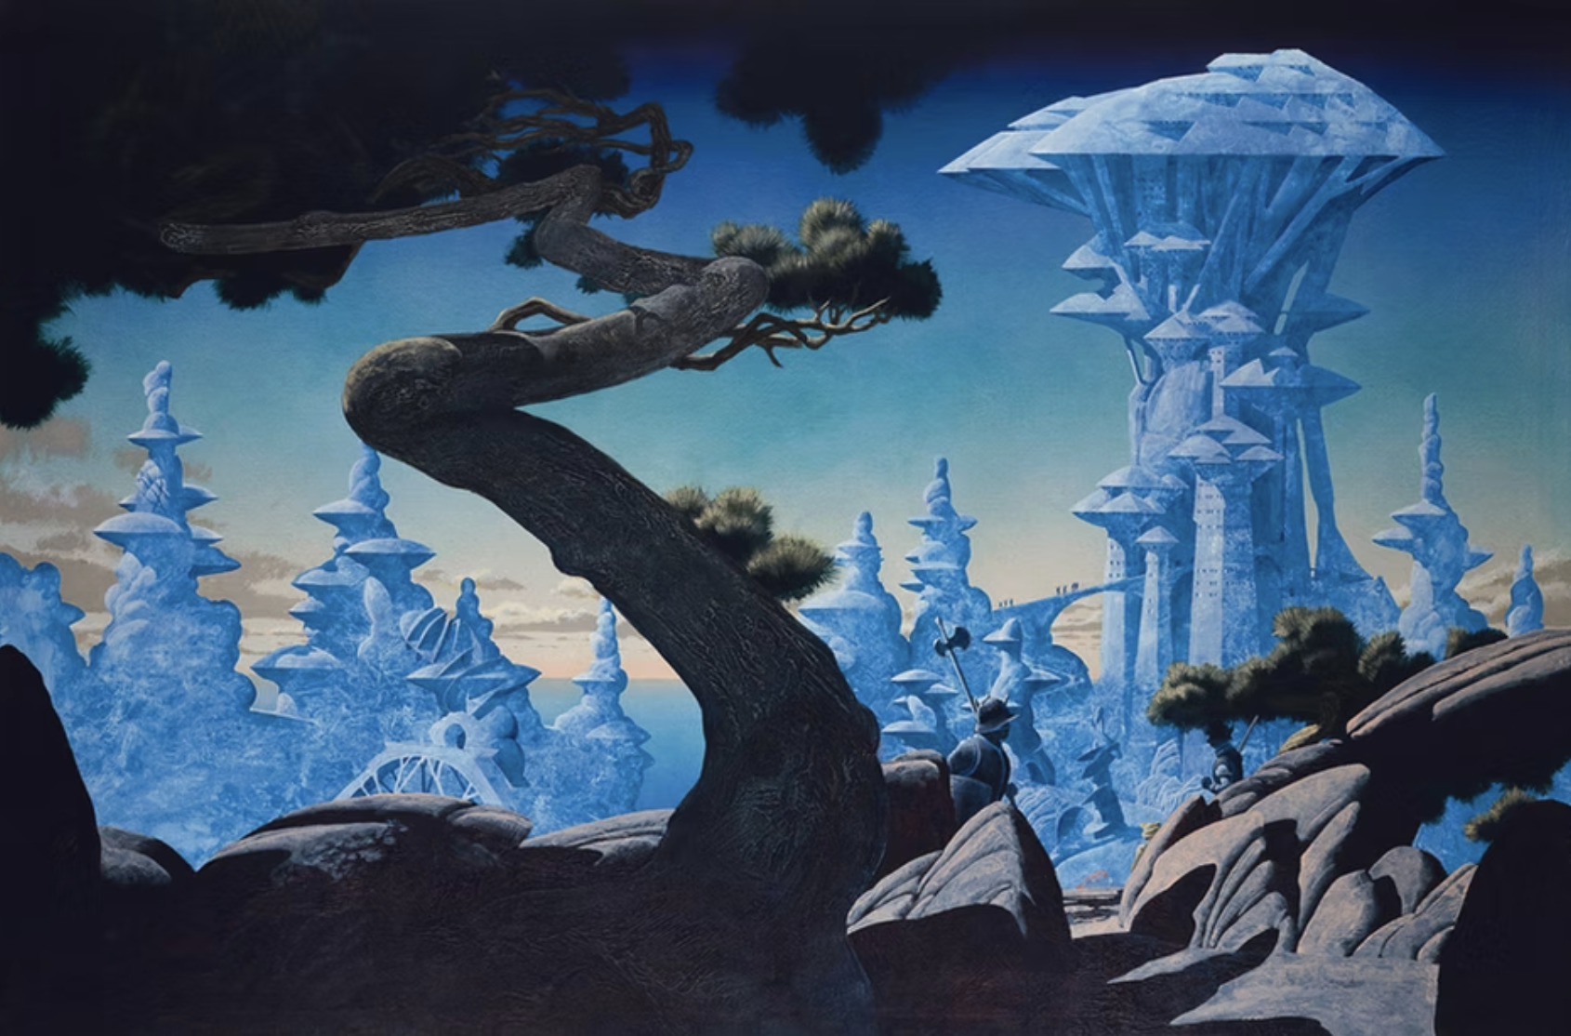
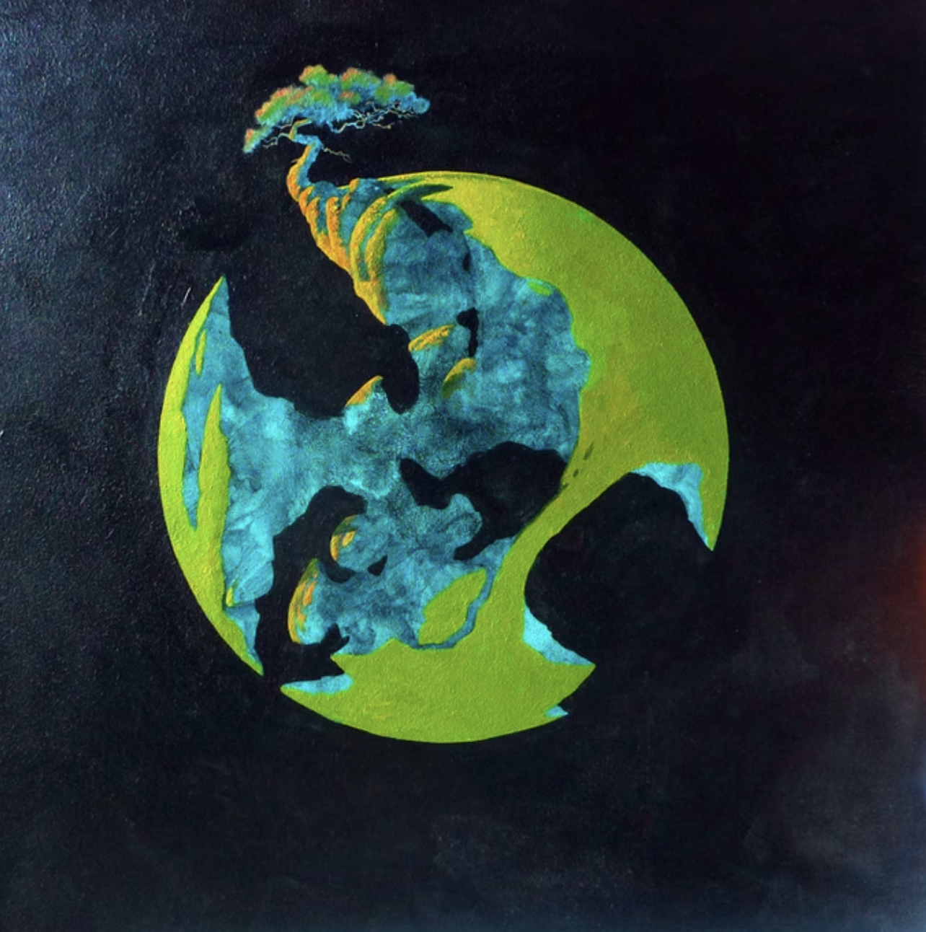
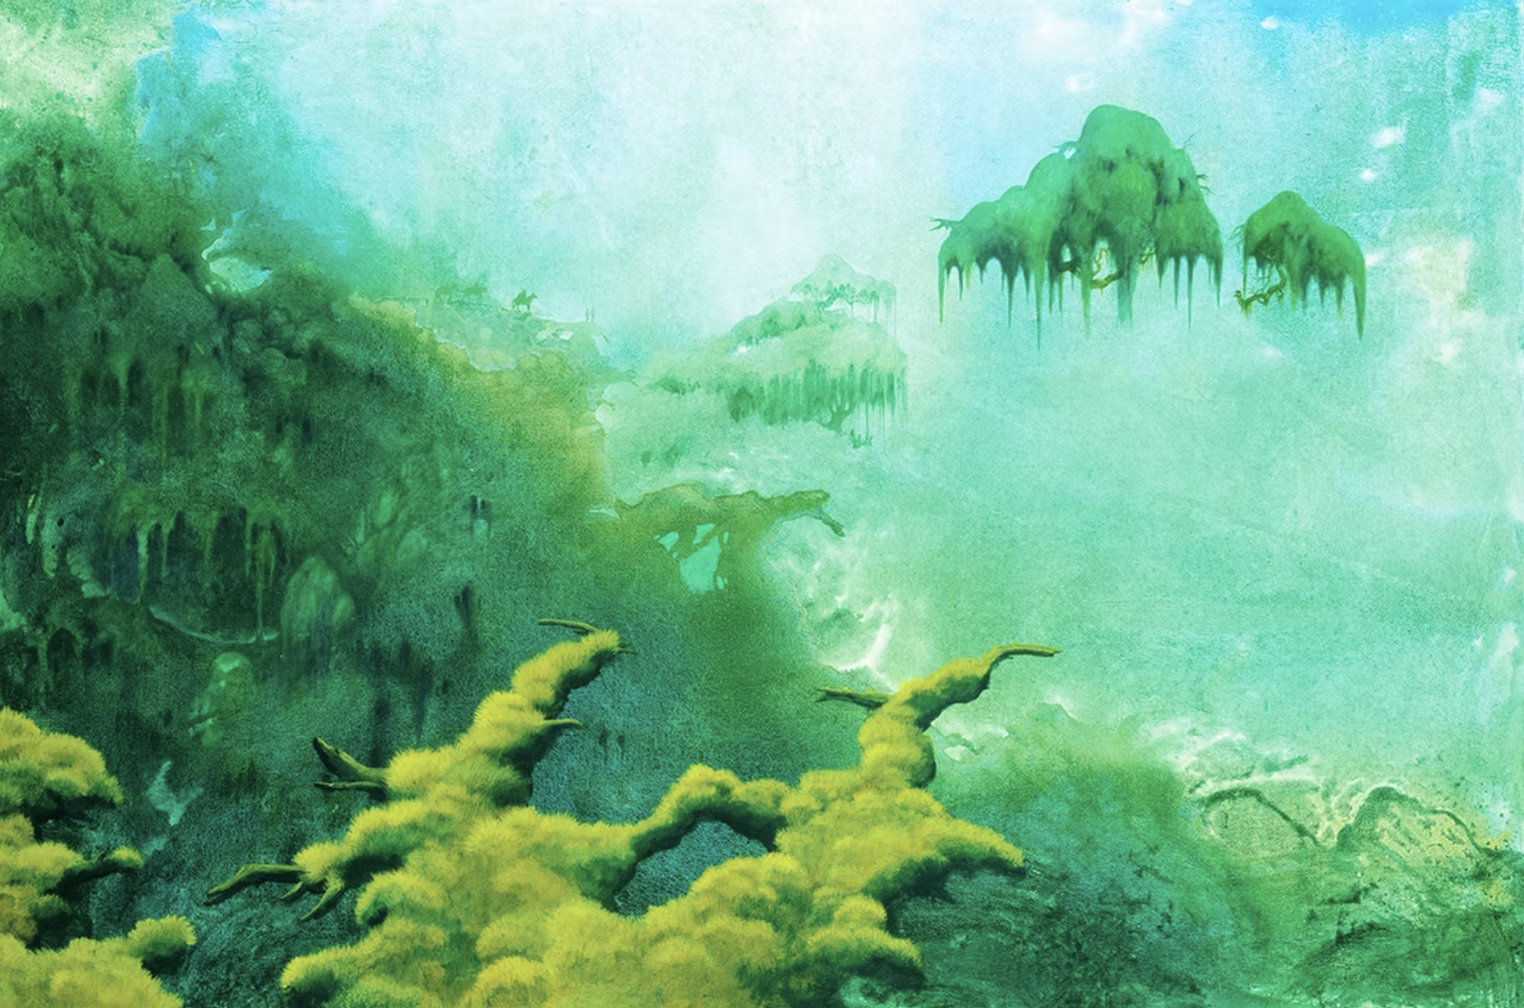
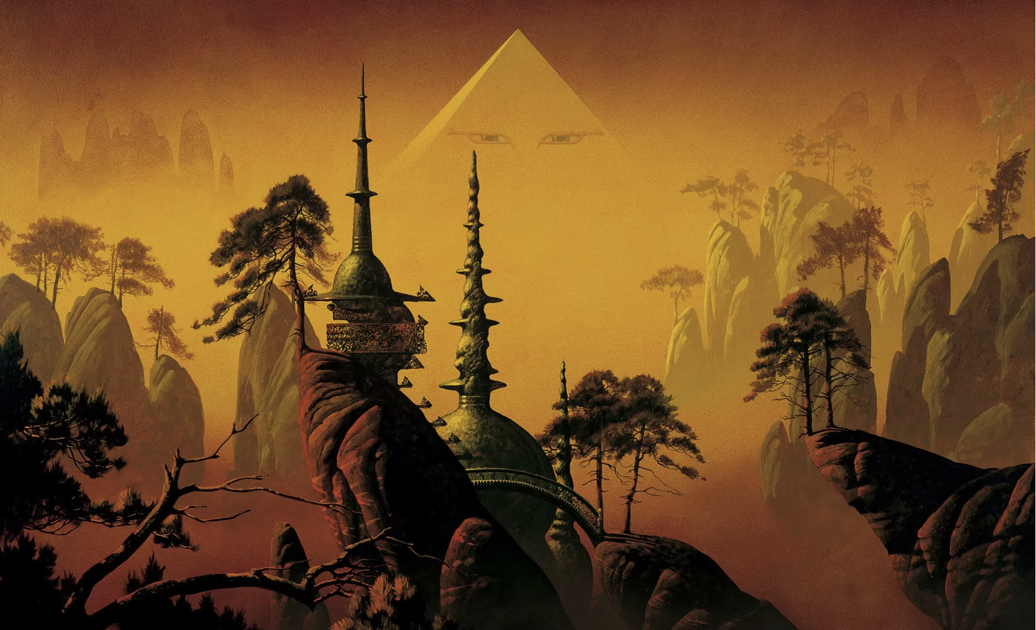
Example of Roger Dean's Work

Slide 14
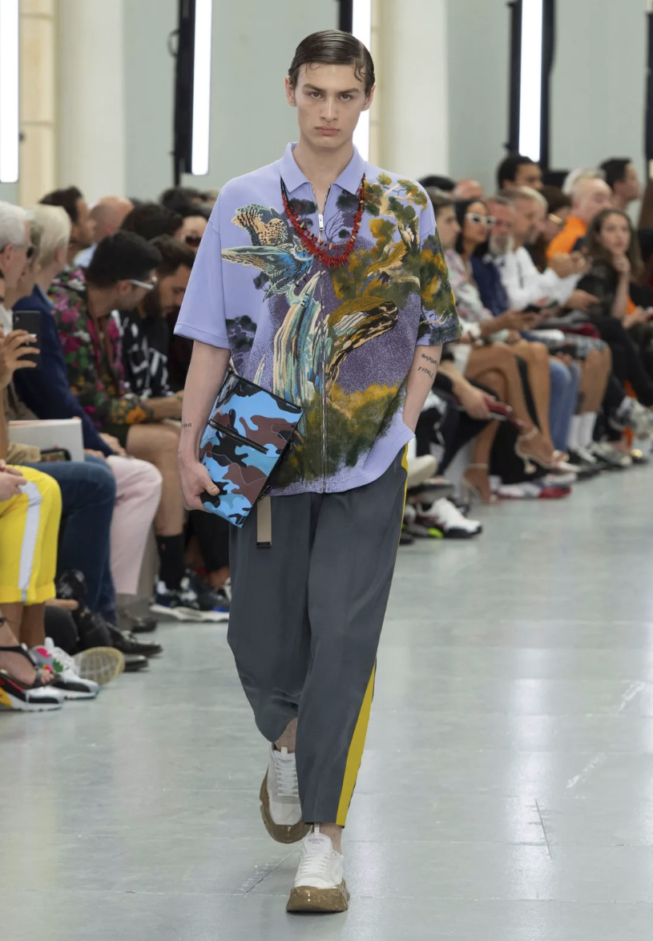
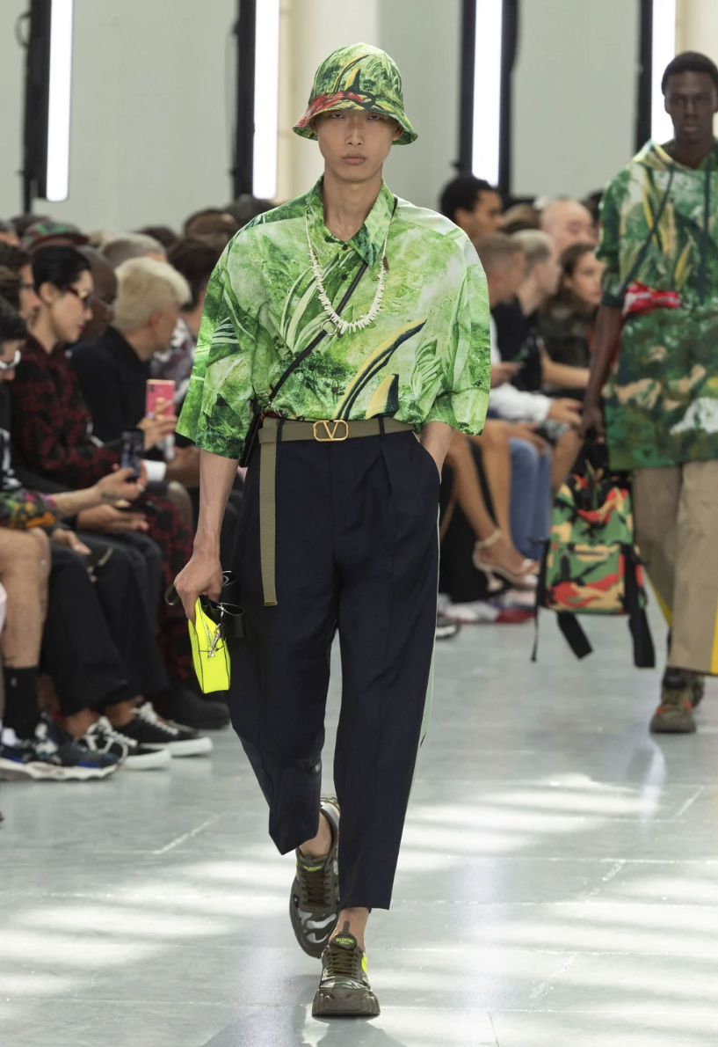
Valentino and Roger Dean
Valentino partnered with Roger Dean for the Summer Menswear Collection in 2020
The collection was designed by Italian designer Pierpaulo Piccoli
The collection is based around many of Roger Dean's iconic pieces, and expressing individuality
The idea of freedom and individuality showcases Valentino's commitment to unique storytelling

Slide 15
Why Roger Dean for Valentino Now?
For the 2020 season, Valentino wanted to move in a fantasy-inspired direction, and Roger Dean is a well-known fantasy artist
This show was dedicated to "dreamers — romantics, idealists and other masters of imaginary worlds"
This collection was started with the idea of mental escape and to go deeper into yourself
Roger Dean's artwork acted as the basis for the rest of the collection with vibrant embroidery accentuating the pieces

Slide 16
Roger Dean and Valentino – According to Theory
This collaboration increases Valentino's credibility by connecting with a highly respected artists who has massively influenced pop culture
This collaboration also reflects luxury's emphasis on individuality, as the collection's main idea if being whoever you want to be
This makes Valentino relevant as they can balance high sophisticated art with pop culture

Slide 17
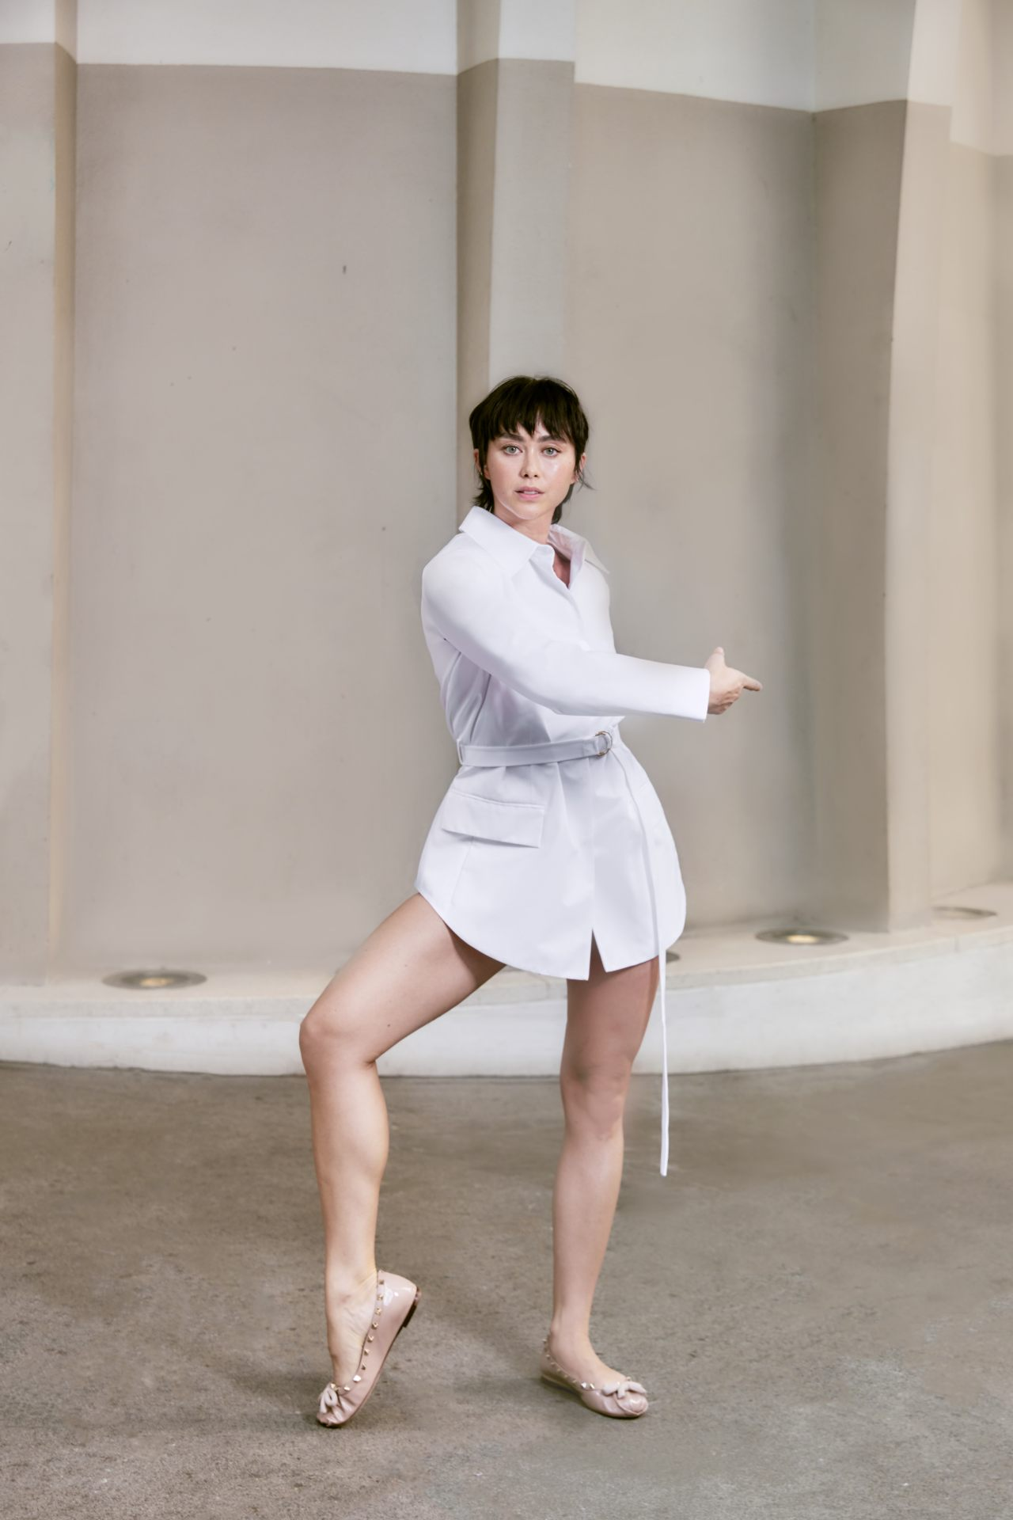
Chloe Leong
Chloe Leong is an Australian choreographer, movement director, and dancer who started her dance journey at the Rambert School of Ballet and Contemporary Dance in London, where she earned a 1st class BA Hons degree.
After graduation, Leong danced with IT Dansa in Barcelona, performing contemporary repertoire and expanding her experience with diverse choreographic styles.
She later joined the Sydney Dance Company where she began choreographing and received the Helpmann Award for 'Best Female Dancer' for in 2015 for her portrayal in 'Quintett' by William Forsythe.
Leong was also the co-director of contemporary dance collective NEW OLD NOW (NON), supporting innovative performance projects and emerging artists.
‍

Slide 18
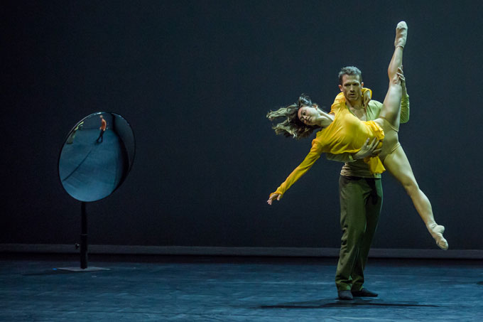
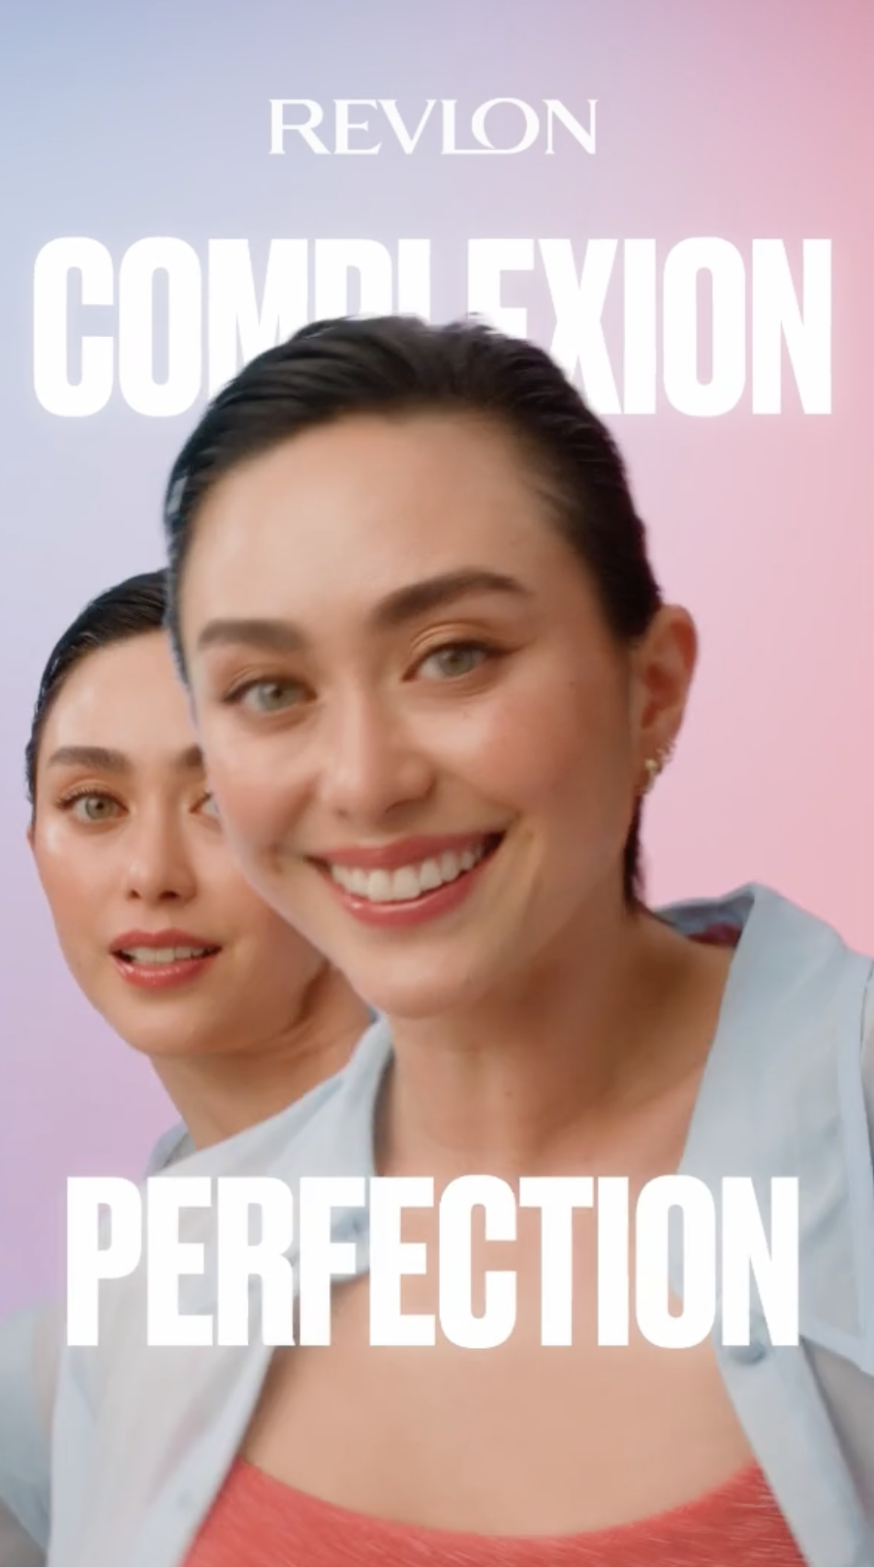
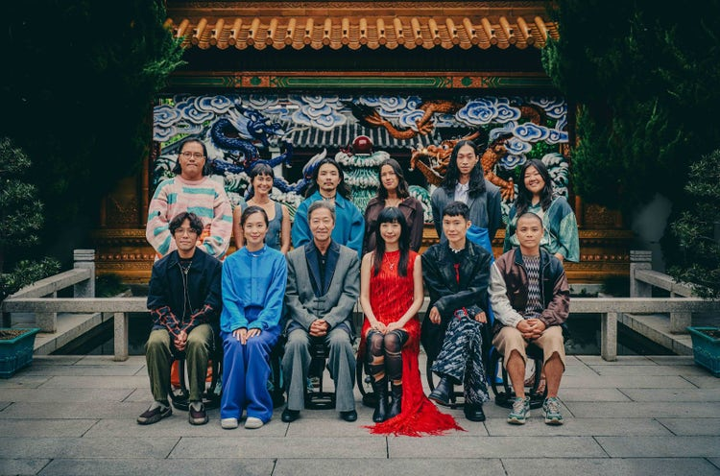
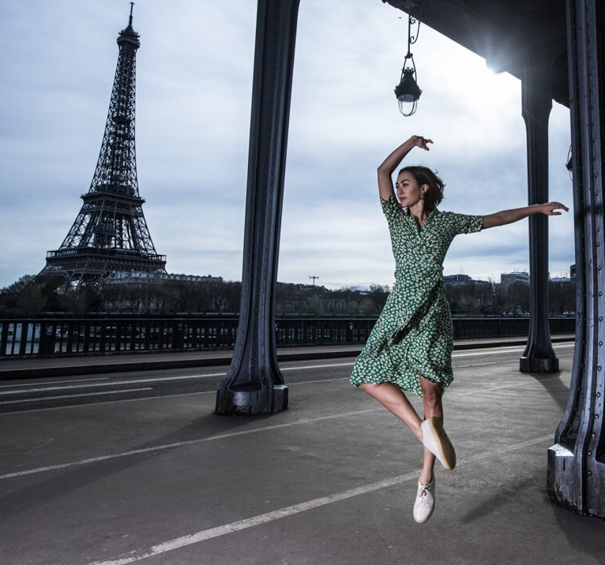
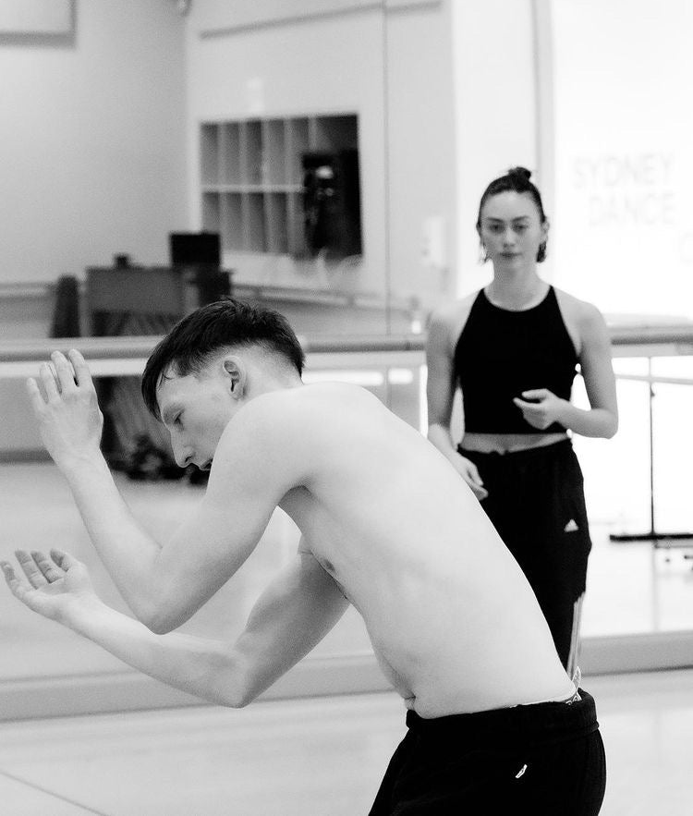
Examples of Chloe Leong's Work
2024 Collaboration with Adobe

Slide 19
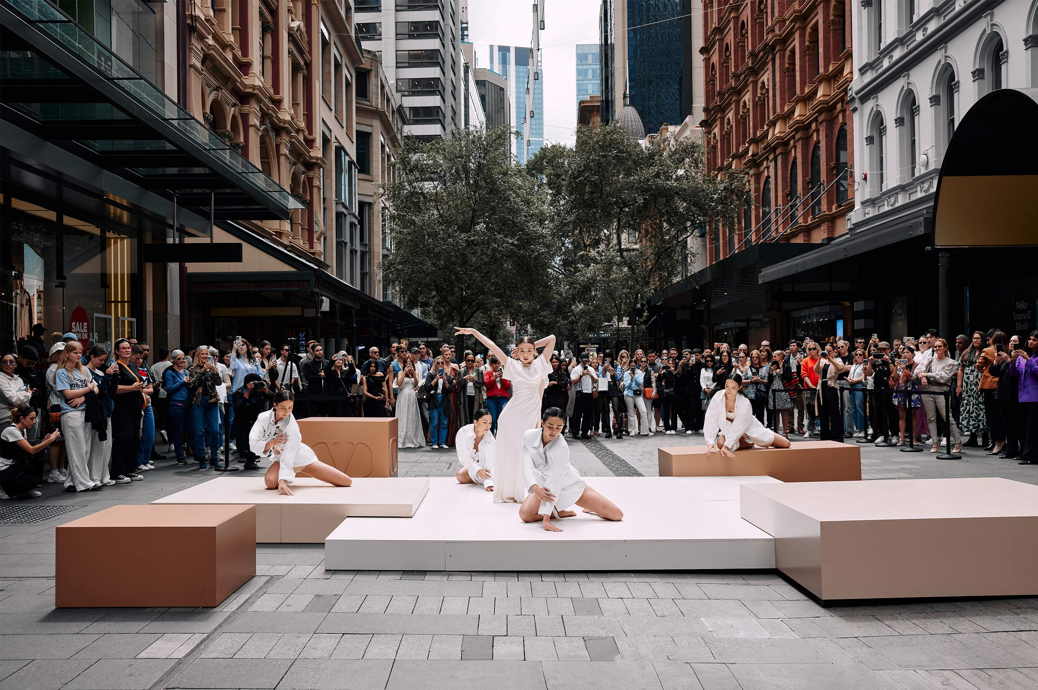
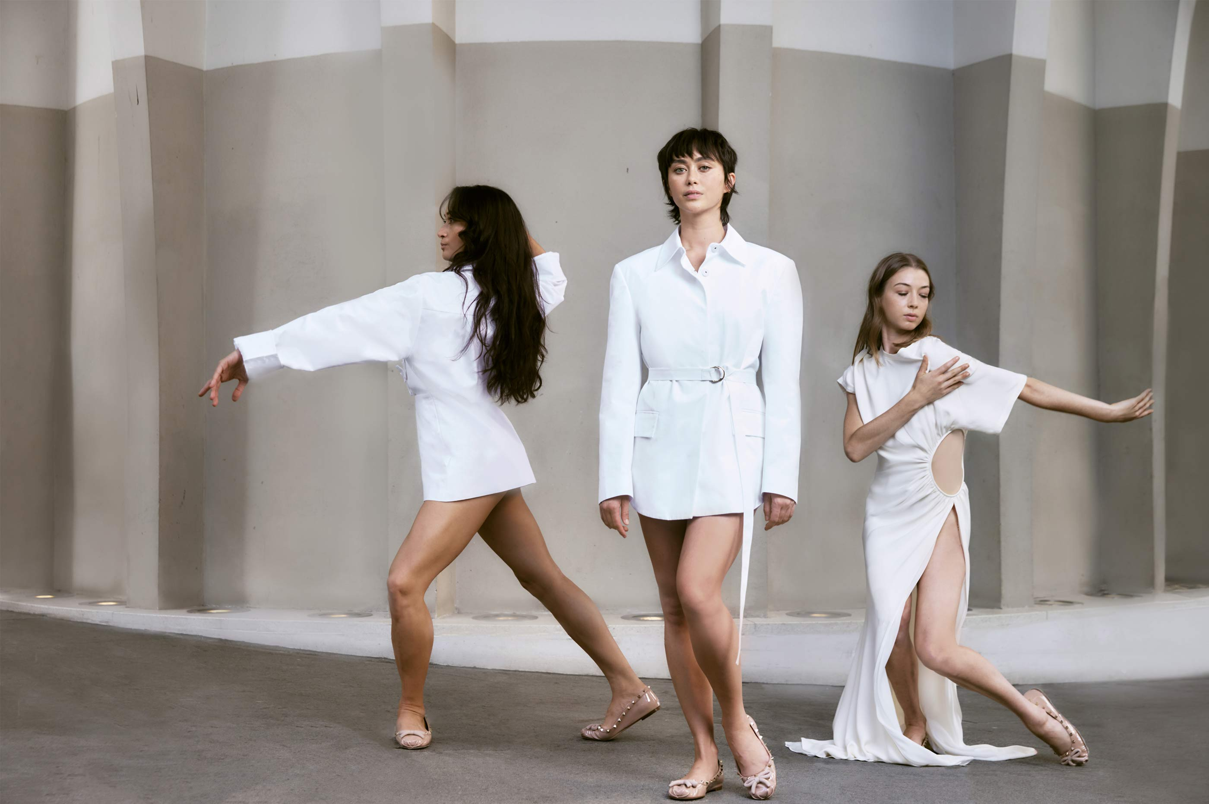
Valentino and Chloe Leong's Work
Valentino invited Chloe Leong to bring their L’École collection to life in in March of 2024 as their first arts-led project created in Australia.
The performance Skin Deep was inspired by Valentino’s L’École Spring/Summer 2024 fashion collection which focused femininity and the human body as well as strength, softness, and emotion. Instead of showing clothes only on a runway or online, Valentino wanted the clothes to be experienced through movement (dance).
Leong directed and collaborate with dancers to wear the clothing while performing in public areas of Sydney to fulfill the brands' goal of making high fashion feel more accessible.
The nontraditional location allowed everyday passersby to encounter the work outside of a runway or theater setting.
The choreography drew inspiration from the runway show where the collected debuted.

Slide 20
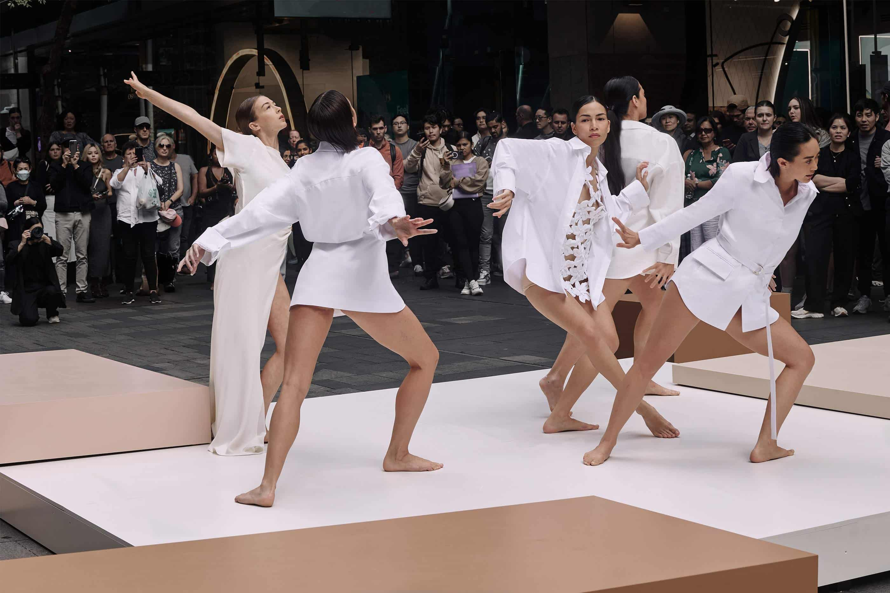
Why Chloe Leong For Valentino Now?
Valentino’s artistic vision for their L’École collection emphasized performance-based interpretation rather than a stereotypical fashion show.
Valentino has recently been exploring artistic collaborations to make their products more immersive for audiences, and Chloe Leong was chosen as a fitting collaboration due to her strong background in contemporary dance and chorography, as well as her extensive experience translating ideas into visual storytelling.
As a choreographer and performer, she could use dance to express Valentino's brand identity and emotional depth beyond traditional marketing tactics.
Leong's ability to capture audience's attention in unconventional spaces allows her to express the artistic approach Valentino wanted to portray.

Slide 21
Leong and Valentino- according to luxury theory
This collaboration increases Valentino’s credibility by connecting with a highly respected choreographer in the contemporary performance world.
It makes Valentino more prestigious and cultural by making a connection between fashion and a well-loved artform.
The performances focus on movement and interpretation, translating Valentino’s vision into a cultural and artistic story, reinforcing brand identity.
This collaboration also reflects luxury's emphasis on creating individualized experiences and emotional connections rather than practical use for a product.

Slide 22
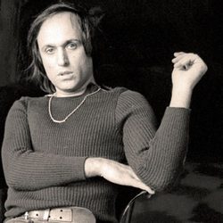
Mario Schifano
Mario Schifano was an Italian painter best known for his Postmodern collages combining advertising imagery, wrapping paper, and painted elements.
He worked in numerous media, shifting between film, music, or photography—often employing more than one at a time.
His later work contains many references to earlier periods in Italian art history.
Born in Homs, Libya on September 20, 1934, he emigrated with his family to Italy at a young age and then was self-taught as an artist. He enjoyed a celebrated career before his death in Rome, Italy on January 26, 1998, at the age of 63.
He won several awards including the Premio Lissone (Lissone 1961), the Fiorino award, and La Nuova Figurazione (Florence, 1963).

Slide 23
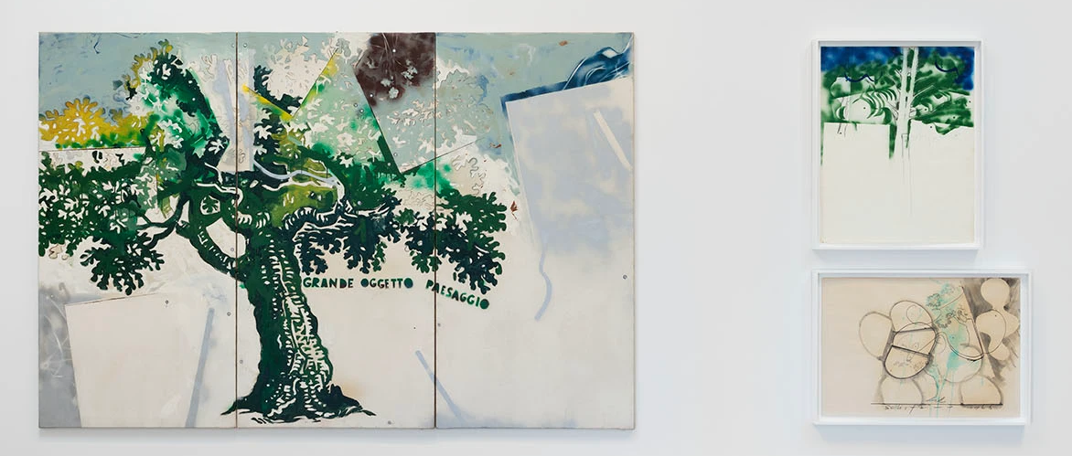
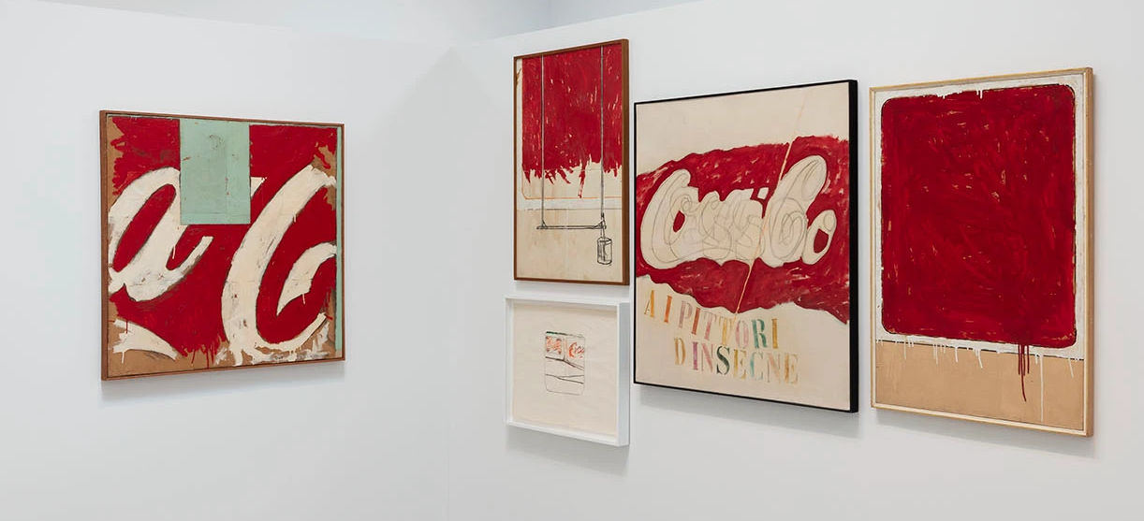
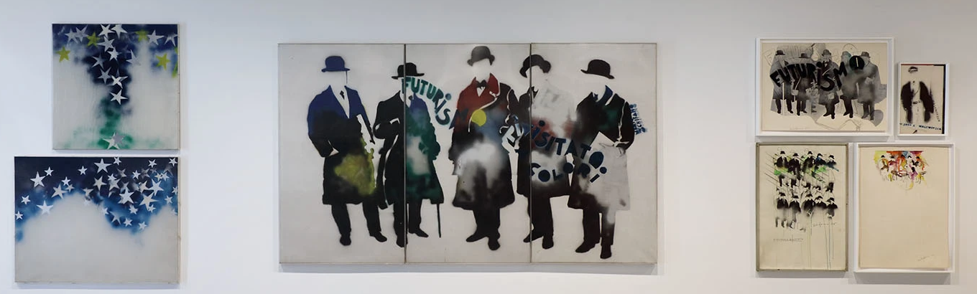
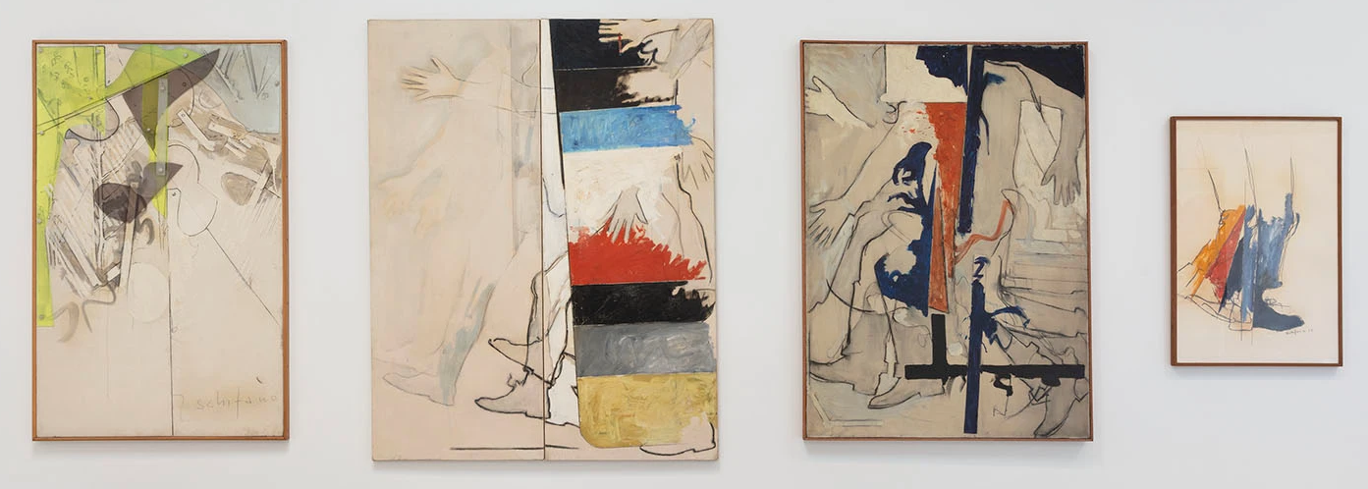
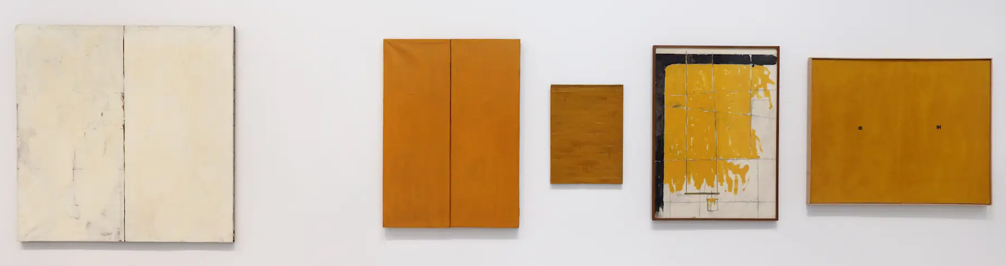
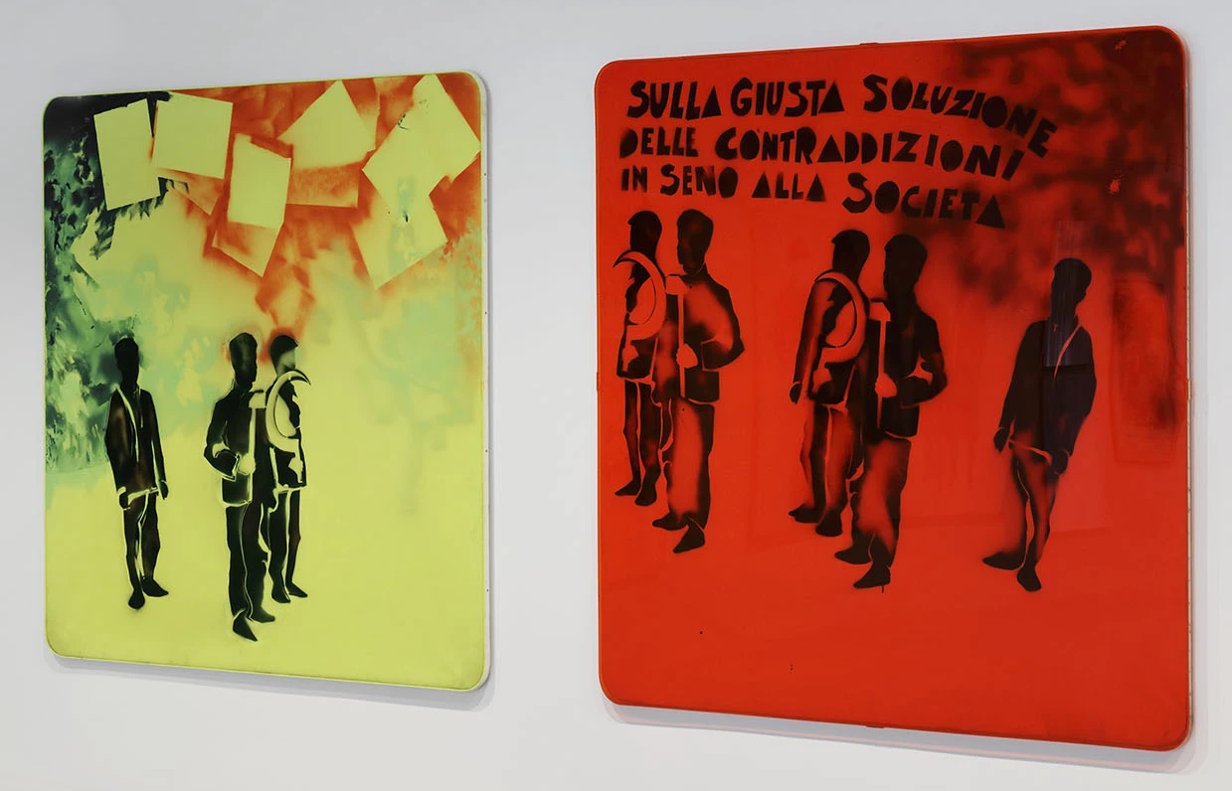
Examples of Mario Schifano’s Work

Slide 24
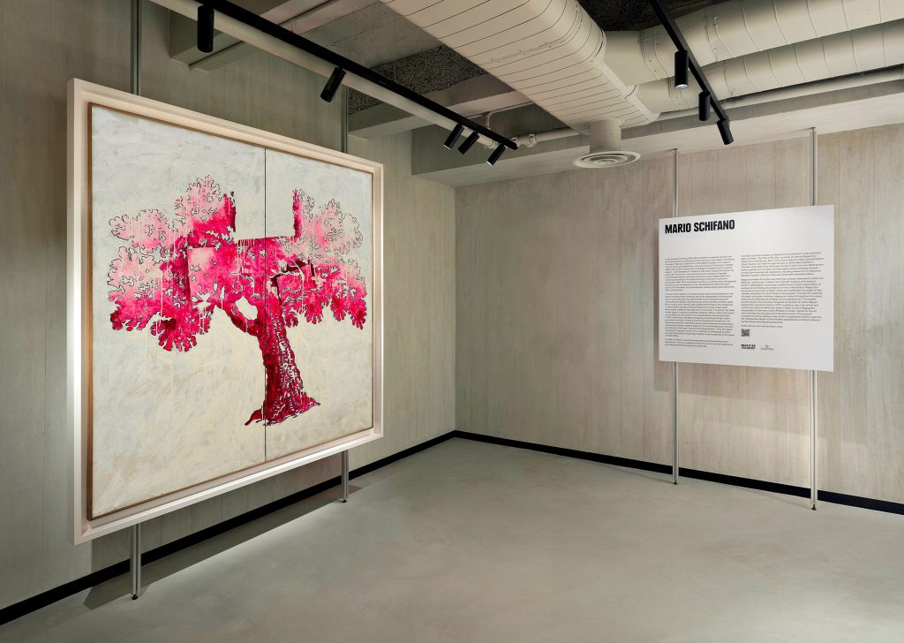
Valentino & Mario Schifano
In November 2023, Valentino collaborated with Magazzino Italian Art, a nonprofit museum and research center focused on Italian art based in Cold Spring, New York.
This partnership featured an exhibition of five large-scale paintings by Italian artist Mario Schifano at the new Valentino Madison Avenue flagship store in New York.

Slide 25
Why Mario Schifano for Valentino now?
In 2023, Valentino was engaging in several collaborations with museums, cultural institutions, and artists to strengthen the brand’s identity as a bridge between haute couture and fine art.
  Schifano is a renowned Italian artist based in Rome, and with his art, he bridged the creative energies of Rome and New York. This matches quite well with Valentino’s new store opening in New York, while their headquarters is still in Rome.
  Magazzino Italian Art is the only American museum specializing in Italian art, so the collaboration with them demonstrates Valentino’s commitment to fine art whilst still reflecting their Italian heritage.

Slide 26
Mario Schifano and Valentino – According to Theory
This collaboration elevates Valentino’s brand image and credibility as a patron of the arts by displaying a renowned Italian artist’s work.
This collaboration also celebrates and reinforces Valentino’s Italian heritage and origin through this highlighting of Italian art.
Mario Schifano’s art blended pop culture with traditional techniques, which aligns well with Valentino’s brand of maintaining their heritage while staying relevant in modern times.

Slide 27
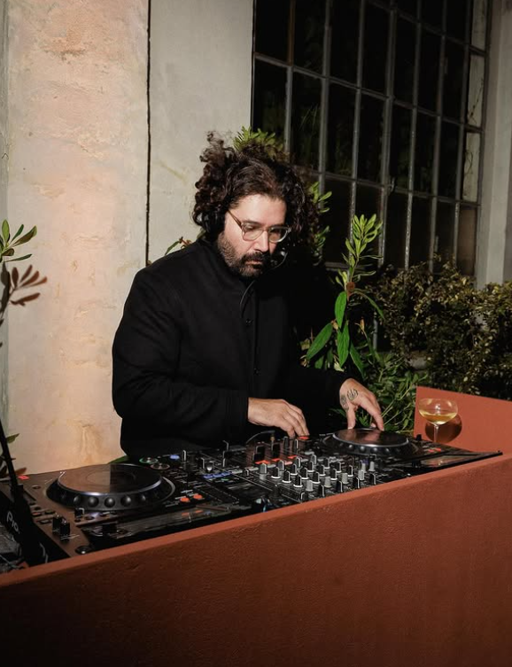
Giorgio Di Salvo
Started his work in the 1990 rooted in hip hop, which then translated to independent work in graphic design and fashion
Launched United Standard in 2015, which became a cultural platform for collaboration in Milan
Jumped into the world of music production, multimedia devices, electronics, and sound synthesis
Now he creates sound objects that are not only technology but also functionality and design

Slide 28


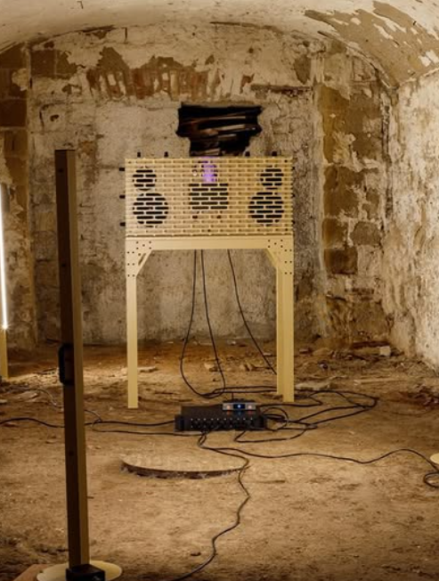
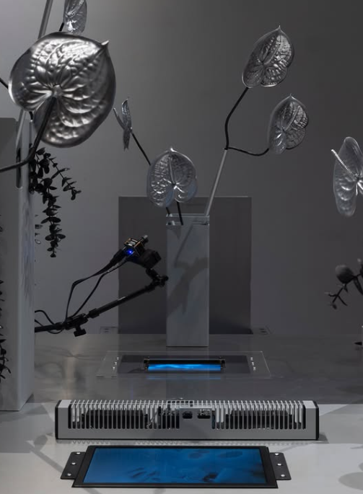
Examples of Giorgio Di Salvo’s artwork

Slide 29
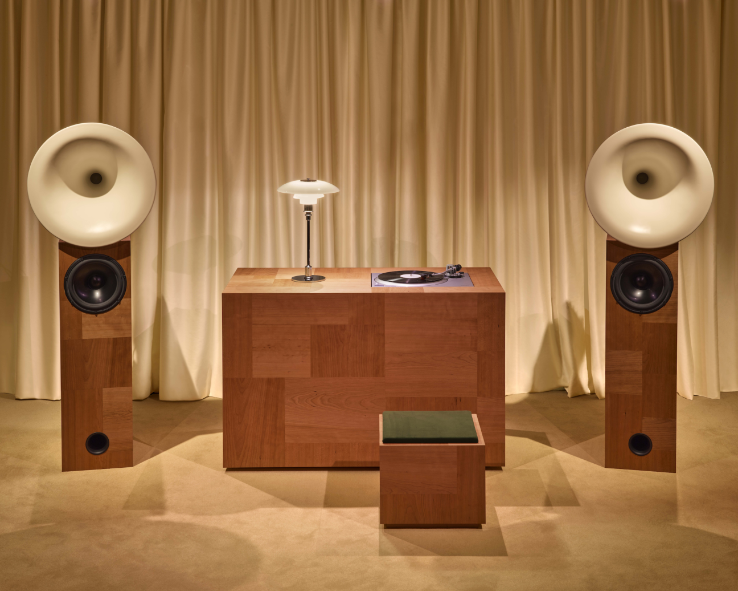
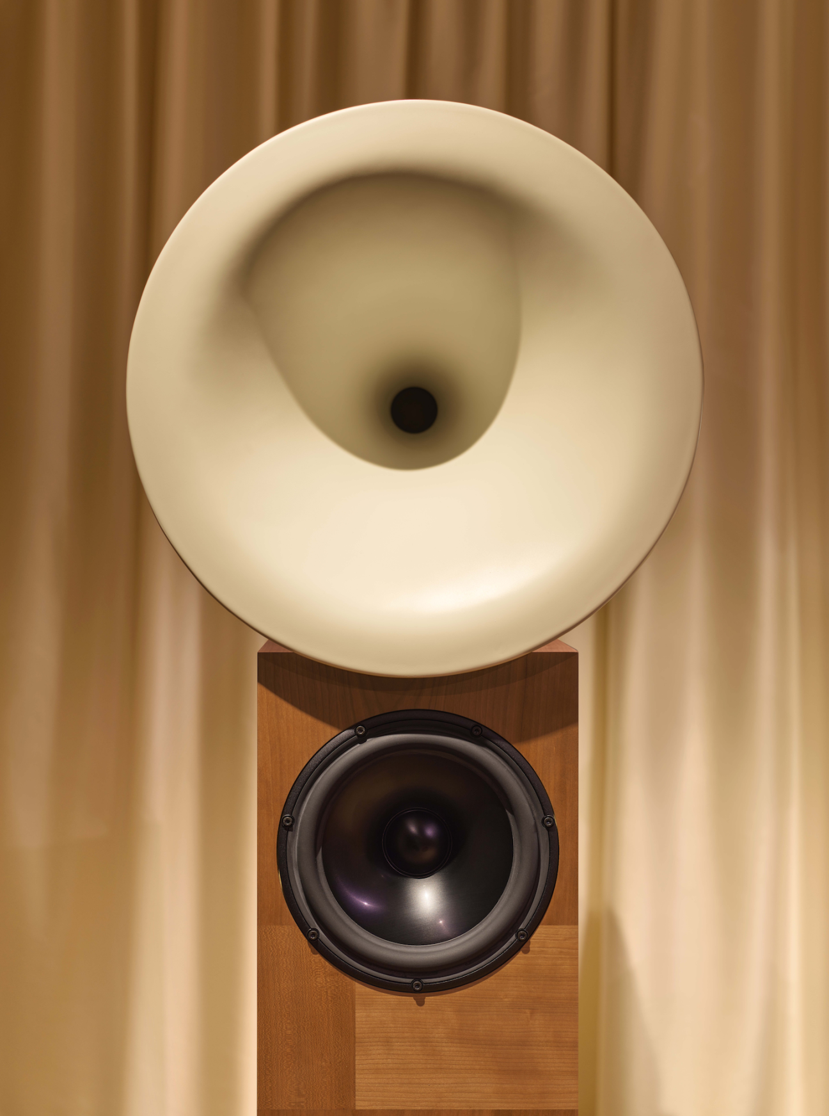
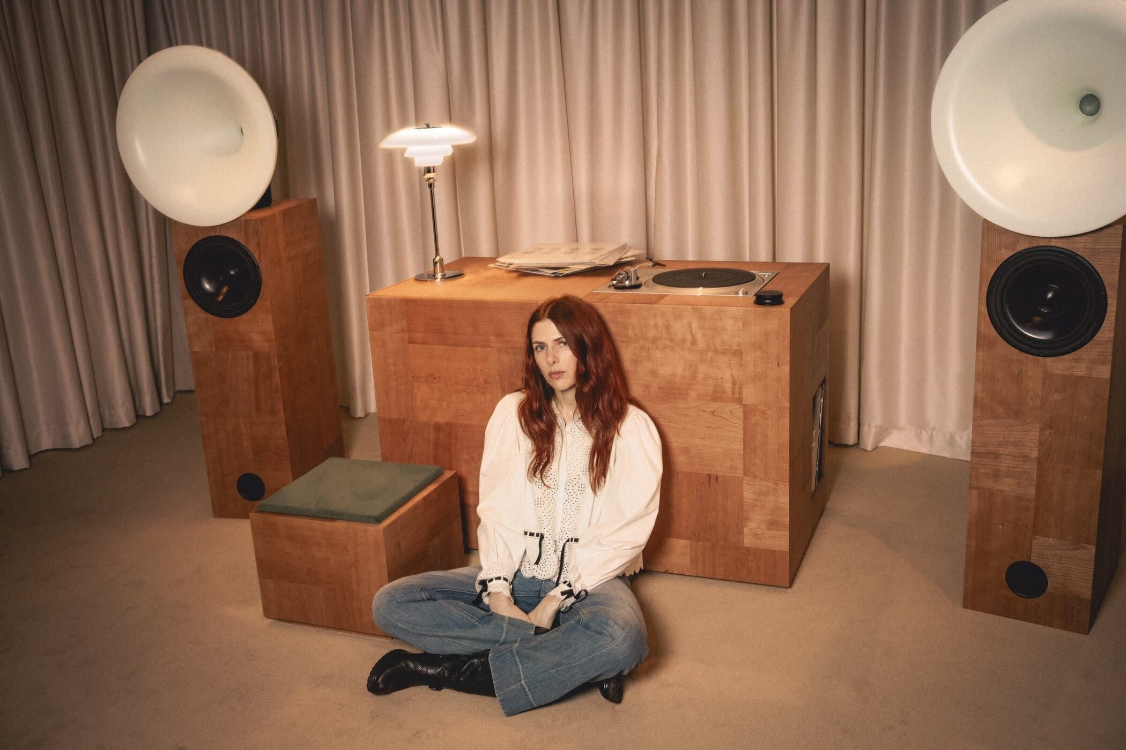
Valentino & Giorgio Di Salvo
Valentino collaborated with Giorgio Di Salvo to create “L’Atelier Sonore” at Madison Avenue boutique in New York in May 2025
The activation is an immersive listening room in collaboration with Terraforma, turning sound and architecture into one
Features forward-thinking artists on vinyl for a 10-hour live program

Slide 30
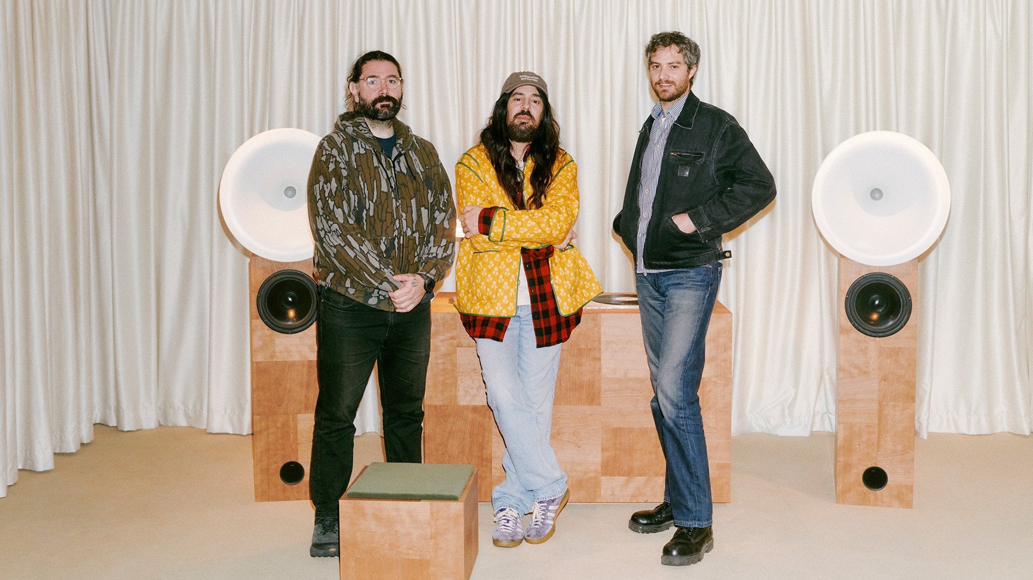
Why Giorgio Di Salvo for Valentino now?
Alessandro Michele became the creative director in 2024
Aims to blend elegance while modernizing
Goals to attract younger audiences and emphasize individuality and expression
This activation is meant to showcase a rich and sensuous vision with a vintage flair

Slide 31
Valentino & Giorgio Di Salvo – according to luxury theory
This collaboration demonstrates a desire for the brand to gain recognition of craftsmanship beyond fashion.
The collaboration strategically highlights Valentino’s values of creativity, innovation, and inclusivity, which are all encompassed by this sound experience.
Modernizes luxury to remain relevant and progressive without losing its heritage.

Slide 32
References
https://en.wikipedia.org/wiki/Anish_Kapoor
https://www.lissongallery.com/news/orizzonti-rosso-featuring-anish-kapoor-at-palazzo-mignanelli-23-rome-italy
https://www.artnet.com/artists/mario-schifano/
https://news.artnet.com/art-world/valentino-magazzino-mario-schifano-2394885
https://www.magazzino.art/visit/exhibitions/mario-schifano-the-rise-of-the-60s
https://www.rogerdean.com/paintings
https://hypebeast.com/2020/3/valentino-crossbody-roger-dean-red-dragon
https://tradingboundariesfineart.com/news/3-valentino-roger-dean-collaboration-spring-summer-2020/
https://www.russh.com/chloe-leong-valentino-lecole-sydney/
https://harpersbazaar.com.au/vanentino-lecole-skin-deep/
https://www.chloeleong.com.au/
https://www.valentino.com/ko-kr/experience/ooh-ecole
https://www.noiregallery.com/artist/giorgio-di-salvo/
Valentino Just Changed What a Brand Activation Can Look Like With Its Latest New York Project

